Slide 1
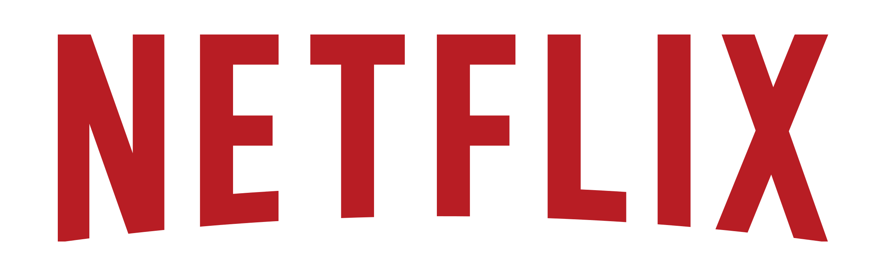
IT Infrastructure & Machine Learning Application
Group 13
Craig Standley
Cole Teza
Jerzy Barbato
Miguel Calleja
Robert Fazio
Notes:
Netflix is an American entertainment company founded on August 29, 1997, in Scotts Valley, California.
It specializes in providing streaming media and video-on-demand services online and DVD by mail.
In 2013, Netflix expanded into film and television production, as well as online distribution.
Netflix released an estimated 126 original series or films in 2016, more than any other network or cable channel.
Revenue: US$8.83 billion (2016)
In April 2017, Netflix reported having over 98 million subscribers worldwide, including more than 50 million in the United States.
Seen major growth with an added 7.05 million subscribers during the fiscal fourth quarter (2016)
With this growth in subscribers and content our goal was too design a IT architecture and a machine learning algorithm which could classify content for easier library searches

Slide 2
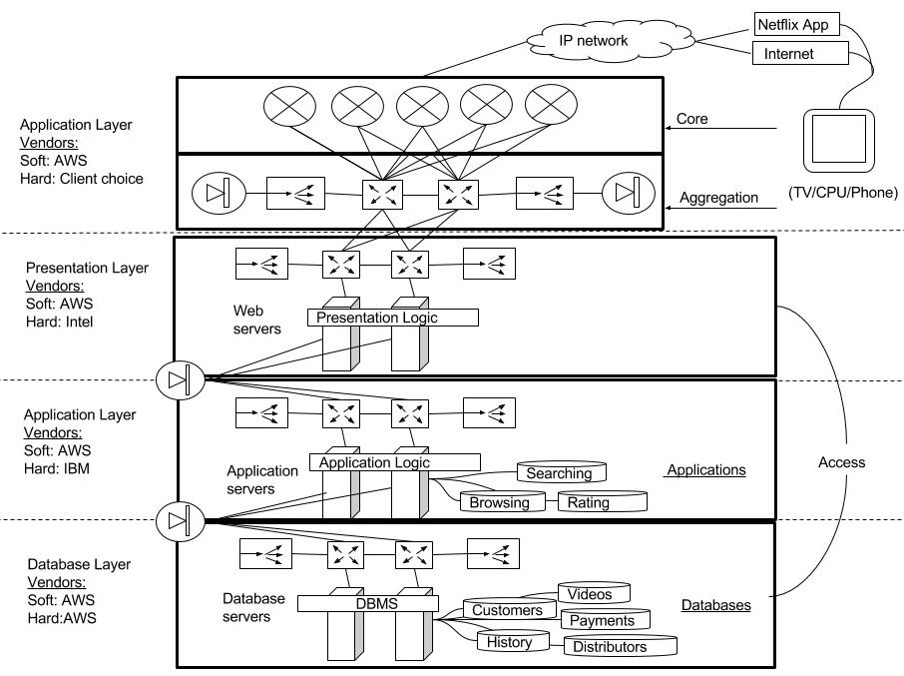
NETFLIX : Traditional Data Center Architecture
Figure 1 : Fully integrated Netflix database architecture diagram.
1. Log on to Netflix from device.
2. Connect from IP network to AWS routers.
3. AWS routing through each layer’s switches and servers (Load Balancers and firewalls).
4. Access necessary databases and repeats per request.
Notes:
In order to efficiently offer their services to members , Netflix needed a tiered client server architecture for their software and hardware . This is critical as it allows Netflix’s application on the client end to communicate with the Netflix web server to watch content online or allow for other certain functionality. We identified that a 4 tiered architecture would meet the requirements of the application.

Slide 3
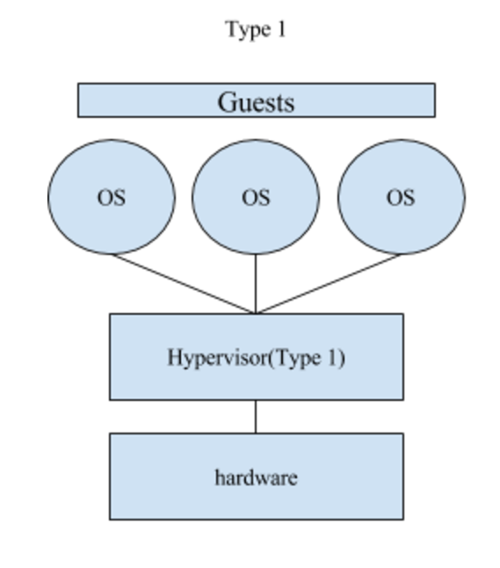
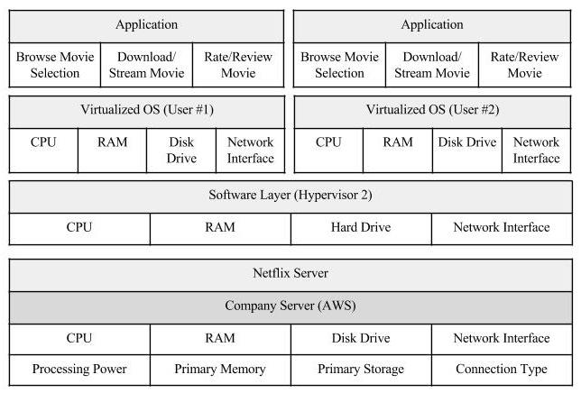
NETFLIX :Virtualization
Figure 2 : “Bare-metal” virtualization works strongly with Netflix in order to increase the ability to handle traffic
Notes:
if we virtualize our Network and Processing on a type 1 virtualization method we can maximize the use value of each machine requiring less resources from AWS, increasing scalability and reducing costs.
Network: Network Virtualization creates the software equivalent of a switch allowing for switching to occur within a system and for it be programmed and adjusted to tailor the firm's needs.
Processing: Process Virtualization utilizes VRAM (virtual ram) and virtual processors to increase the usability of a server.

Slide 4
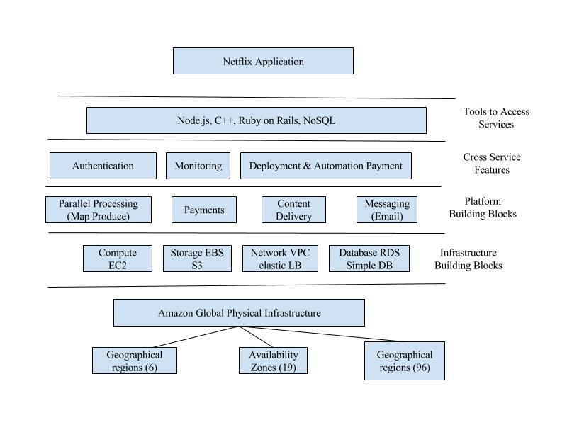
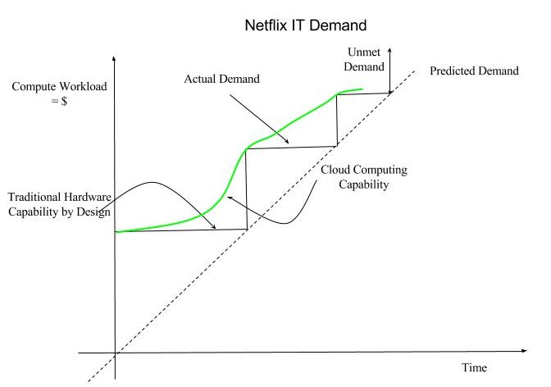
NETFLIX : Cloud Computing
Figure 4 : Cloud Computing can providing IT to users the same way conventional companies provide utilities. The figure above illustrates how cloud computing can provide extra elasticity to Netflix’s IT system
Figure 3: above is a diagram of Netflix’s data center represented with a cloud computing service
Notes:
we realized that Netflix had to move away from vertically scaled single points of failure, like relational databases in our datacenter, and instead went towards highly reliable, horizontally scalable, distributed systems in the cloud. We chose Amazon Web Services (AWS) as our cloud provider because it provided us with the greatest scale and the broadest set of services and features.
Elasticity of the cloud allows Netflix to add thousands of virtual servers and petabytes of storage within minutes, making such an expansion possible with out wasting time and money on new server racks. On January 6, 2016, Netflix expanded its service to over 130 new countries, becoming a truly global Internet TV network. Leveraging multiple AWS cloud regions, spread all over the world, enables us to dynamically shift around and expand our global infrastructure capacity, creating a better and more enjoyable streaming experience for Netflix members wherever they are.
the cloud allows one to build highly reliable services out of fundamentally unreliable but redundant components. By incorporating the principles of redundancy and graceful degradation in our architecture, and being disciplined about regular production drills using Simian Army software like chaos monkey, it is possible to survive failures in the cloud infrastructure and within our own systems without impacting the member experience.

Slide 5
NETFLIX : Our Problem
Problem: Help create a classifier for netflix to determine whether a movie will get a high rating or not.
We accessed the IMDb (Internet Movie Database) 5000 database from Kaggle, Which contains 5,000 popular films.
Our Database has the following attributes
Movie Title
Content Ratings
Director's Name
Actor’s Name
Genre
Plot Words
Given this data we implemented the Naive Bayes classifier to categorize the films by rating, GOOD or BAD (GOOD if IMBD rating ≥ 7.5 and BAD if IMBD rating < 7.5) based on Director, Actors, and movie plot keywords.
Notes:
A lot of netflix’s competitive edge over other competitors (e.g. Hulu Plus, Amazon Video, HBO) is due to its Cine-Match Algorithm.
Recommendations is a powerful tool for data mining which helps Netflix determine Film Quality, Genres & Movie Elements, Anchoring, Movie Fads, and Rating. By using the information gathered above Netflix can more accurately recommend shows and movies to consumers which helps keep consumer retention and subscription rates up.

Slide 6
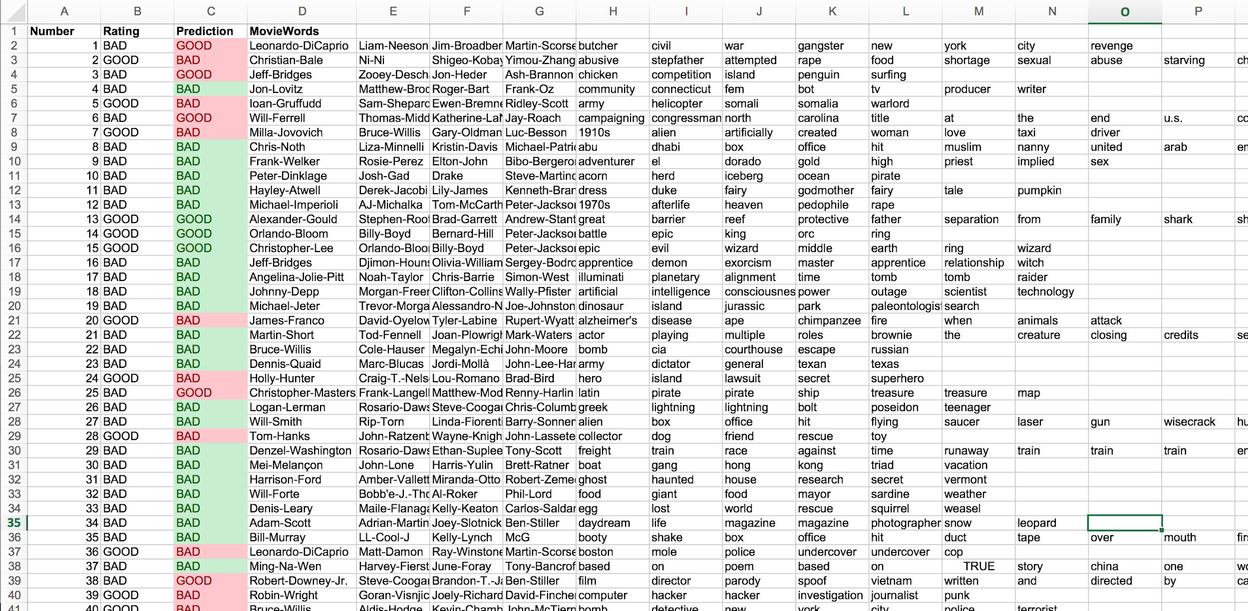
NETFLIX : Machine Learning- Results
We can see that after trained, our machine learning program was able to learn what movies would recieve an IMDb rating less than 7.5 or more than 7.5. With over 100 samples we got a total of 79% correctness from our Navie Bayes machine. With this data Netflix can see the trend that comes out of combination of actors, directors, and plot type to assist them with picking movies to broadcast on their servers or with creating original content.

